Slide 1
Human papilloma virus (HPV)
Presented by: Crixly Viera

Slide 2
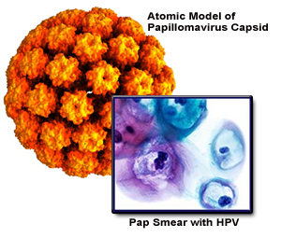
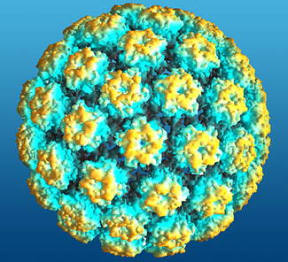
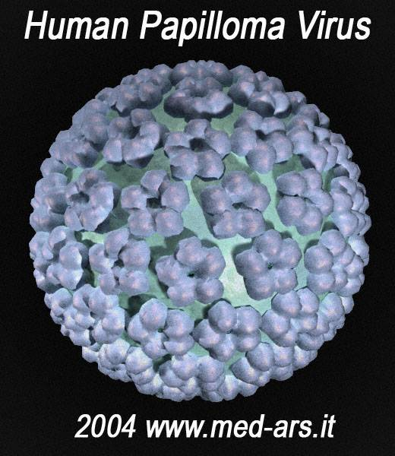
Human Papilloma Virus
HPV

Slide 3
HPV Types
Are referred to as “low-risk” (wart causing) or “high risk” (cancer causing) which basically means whether or not it puts the person at risk for cancer.

Slide 4
Signs and Symptoms
(Most people with HPV do not develop symptoms or health problems) certain types of HPV cause genital warts and others cause cervical cancer and other less common cancers.
Genital warts: usually show up as small bumps or groups of bumps usually in the genital area. They can be raised or flat, single or multiple, small or large, and sometimes cauliflower in shape.

Slide 5
Cont. Signs and Symptoms
They can appear on the vulva, in or around the vagina, or anus, on the cervix, and on the penis, scrotum, groin, or thigh.
Warts may appear within weeks or months after sexual contact with an infected person or they may not even appear at all.

Slide 6
Diagnosis-clinical
There is no general test to check your overall “HPV status”
For genital warts: It’s diagnosed by visual inspection.
For cervical cancer: They look at cervical cell changes (early signs of cervical cancer) by a routine pap test.

Slide 7
Treatment and Prevention
There is no treatment for the virus itself but there are treatments for the diseases that it can cause like
Genital warts: can be removed by patient applied medications like Podofilox or Condylox or the Doctor can provide Cryotherapy which basically freezes off the wart with liquid nitrogen
Cancer types: Surgery, radiation therapy and Chemotherapy.

Slide 8
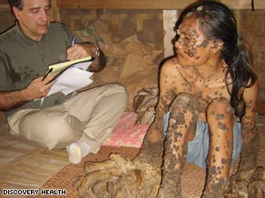
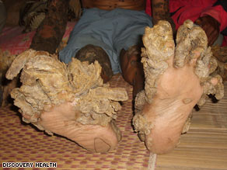
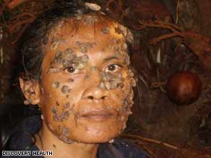
“ Human Treeman”
Has a deficiency of white blood cells & his weakened immune system couldn’t fight the HPV. The virus hijacked his skin cells causing it to produce massive amounts of keratin causing the warts to sprout into dense growths

Slide 9
Refrences
http://www.webmd.com/sexual-conditions/hpv-genital-warts/hpv-treatment-is-there-hpv-cure?page=2
http://www.cdc.gov/STD/HPV/STDFact-HPV.htm#symptoms
Microbiology: A systems approach. Marjorie Kelly Cowan. Kathleen Park Talaro.2009.

Slide 10
THE END

